Slide 1
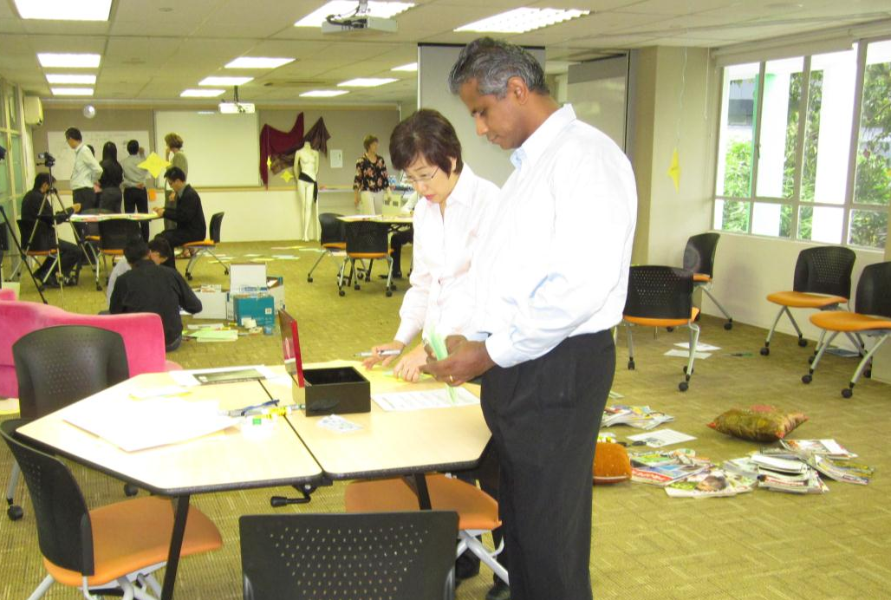
Who are we as teachers? Ecology Room Activities
From The “Who” of Teaching workshop for trainers
Run by Dr Sue Stack and Renee Tan
Institute for Adult Learning, Singapore
November 2011

Slide 2
The challenge:
To create an experience for trainers:
To reflect on aspects of their practice, making the tacit explicit
To help create new conversations about what we value
To help build up a deeper understanding of the being and becoming of a teacher/trainer.

Slide 3
Principles of the ‘ecology room’
The ecology room aims to allow participants to go on their own journey through different activities that help them access their holistic intelligences. People are encouraged to interact, and comment on each others’ artefacts through using post-it notes.
The activities are carefully juxtaposed to enable:
diversity - multiple ways of knowing and experiencing
redundancy and dissonance
liberating constraints
decentralised control
energy flow and iteration
metaphors
feedback
debriefing and reflecting

Slide 4
Look at the cards with teaching roles. Which ones do you like, dislike?

Slide 5
Preferred roles in blue. Disliked roles in pink. Now consider the paradigms and beliefs behind these roles.

Slide 6
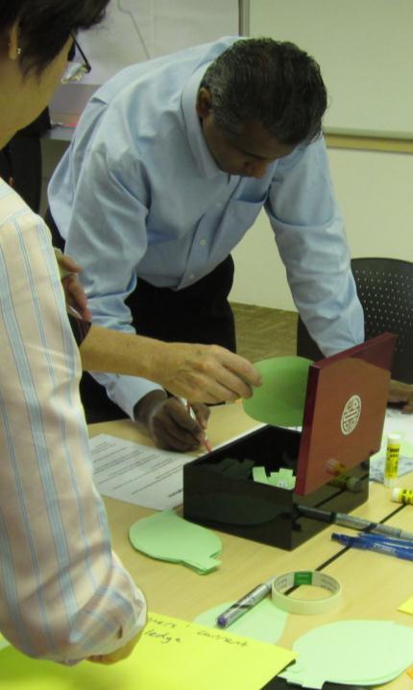
Take an assumption out of the box and consider an opposite

Slide 7
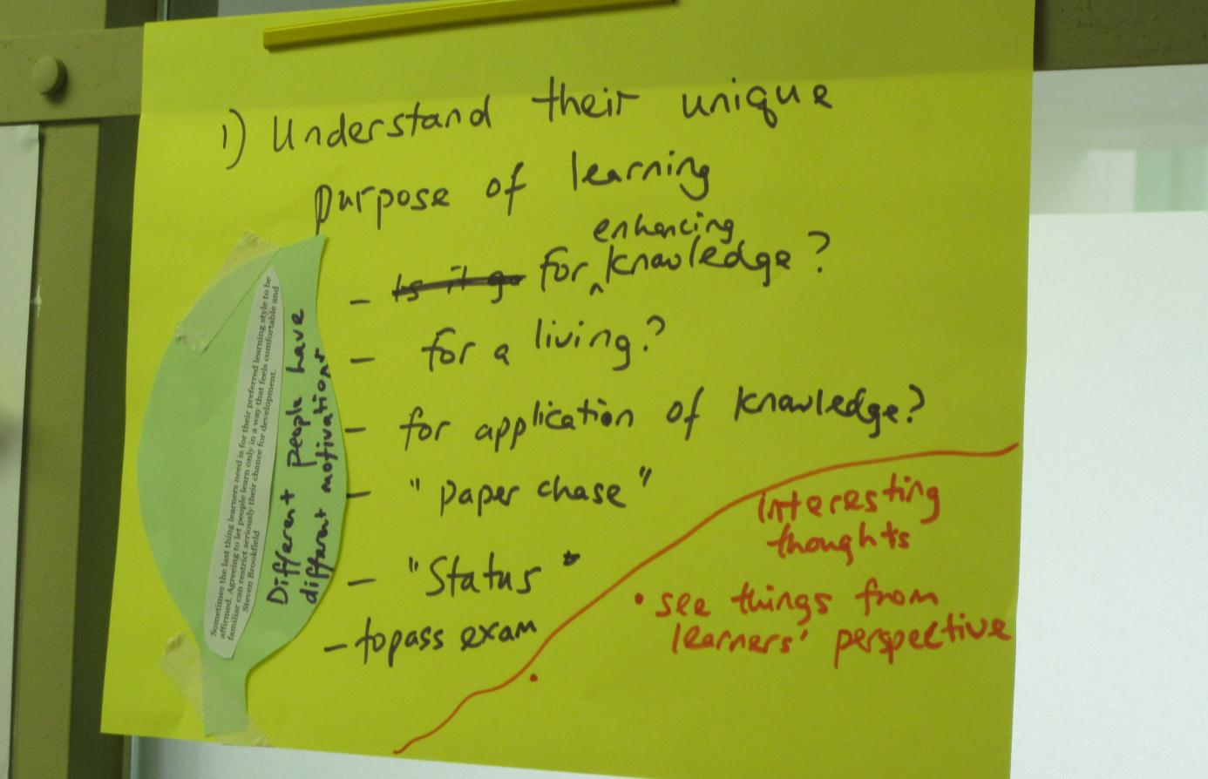
Turning around assumptions

Slide 8
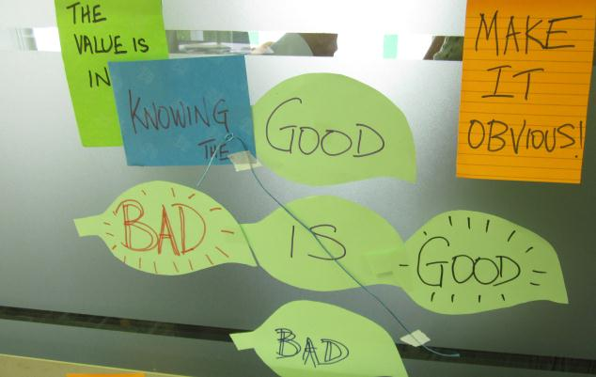
Un-thinking?

Slide 9
Write about an incident that has stayed with you

Slide 10
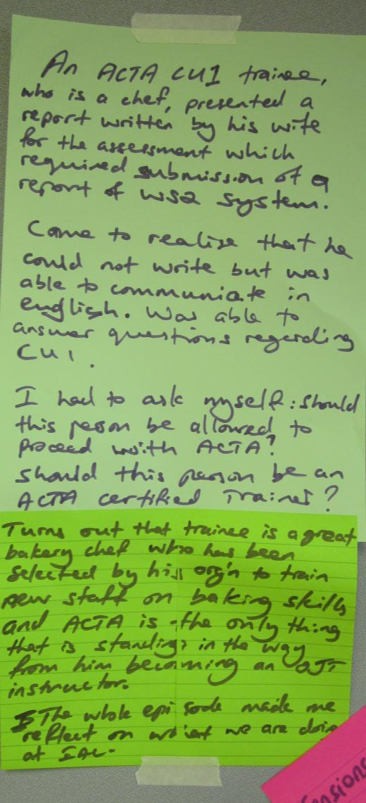

Slide 11
What are your highlights and lowlights on your journey to become a teacher? What helped you overcome the low points?

Slide 12
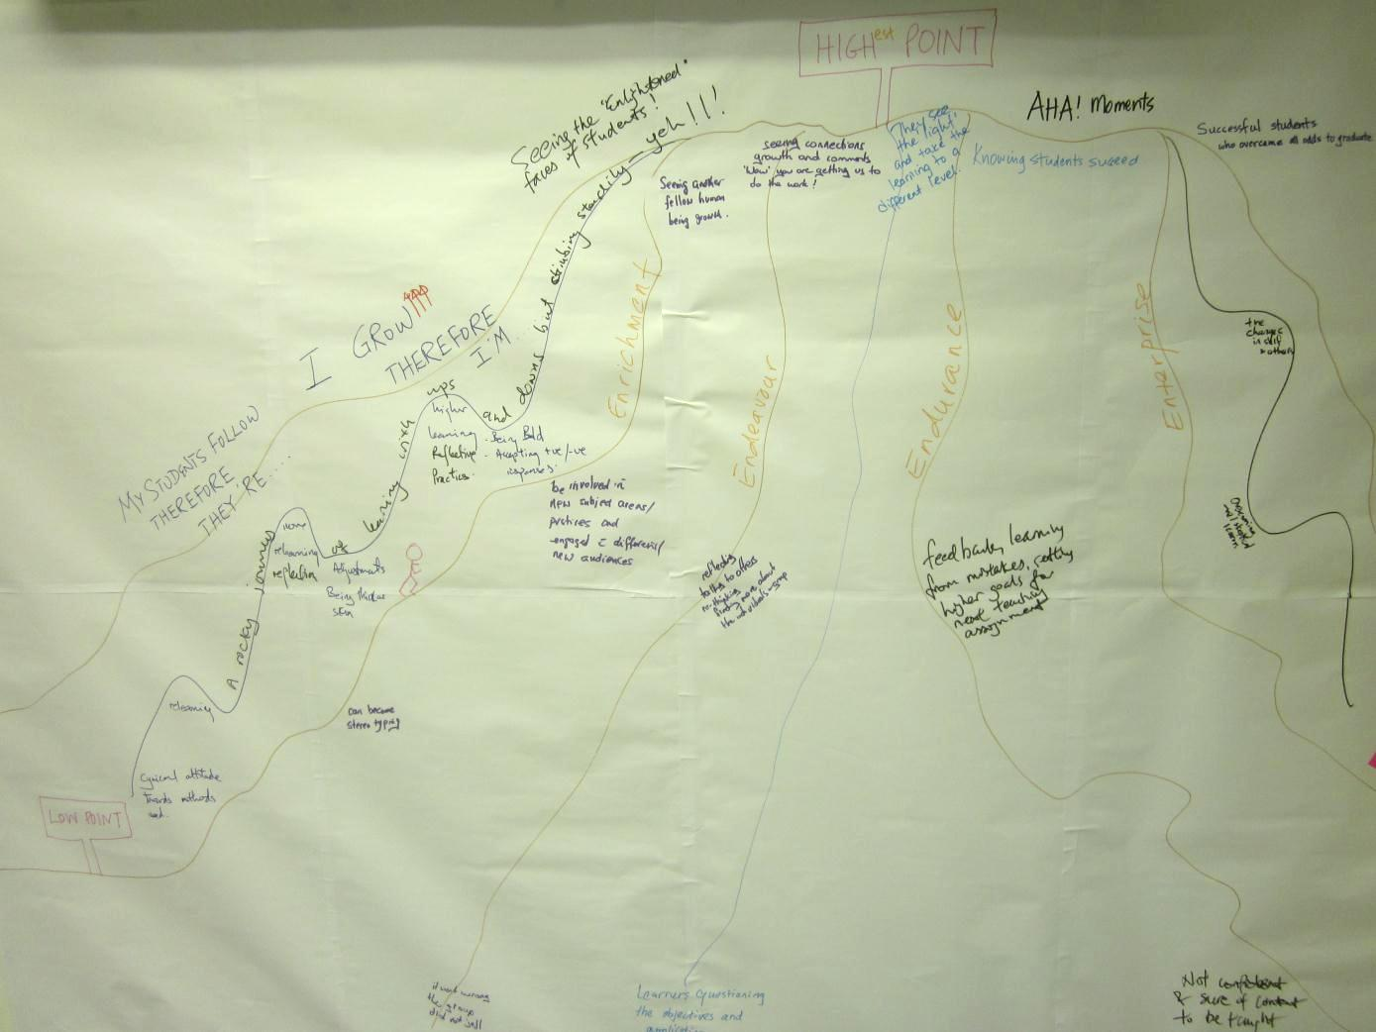
What are your highlights and lowlights on your journey to become a teacher? What helped you overcome the low points?

Slide 13
How would you represent the system and the constraints you are facing?

Slide 14
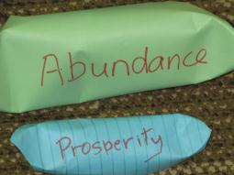
How do you represent the system?

Slide 15
Who am I as a teacher? Choose pictures that help you answer this question.

Slide 16
Who am I as a teacher?

Slide 17
Who am I as a teacher?

Slide 18
Who am I as a teacher?

Slide 19
Who am I as a teacher?

Slide 20
What are the tensions that you are experiencing?

Slide 21
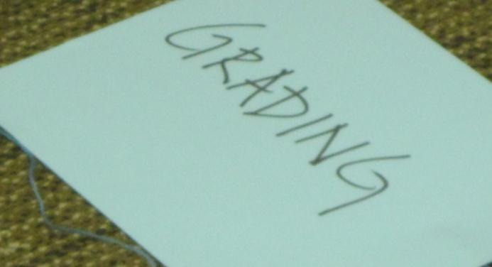
What are your tensions?

Slide 22
Consider a past mentor or teacher that you admire. What qualities did you value?

Slide 23
Consider a past mentor or teacher that you admire. What qualities did you value?

Slide 24
What are the expectations that others have about teachers?

Slide 25
What are the expectations of others about teachers?

Slide 26
What was your vision before teaching? What is your vision now? What has changed?

Slide 27
What do I value in my relationships with my students?

Slide 28
What questions do you have about teaching and learning?

Slide 29
What questions do you have about teaching and learning?

Slide 30
What questions do you have about teaching and learning?

Slide 31
What are your questions about teaching and learning?

Slide 32
Inside the person put the qualities you think good teachers have to be born with. Put outside those things that can be taught.

Slide 33
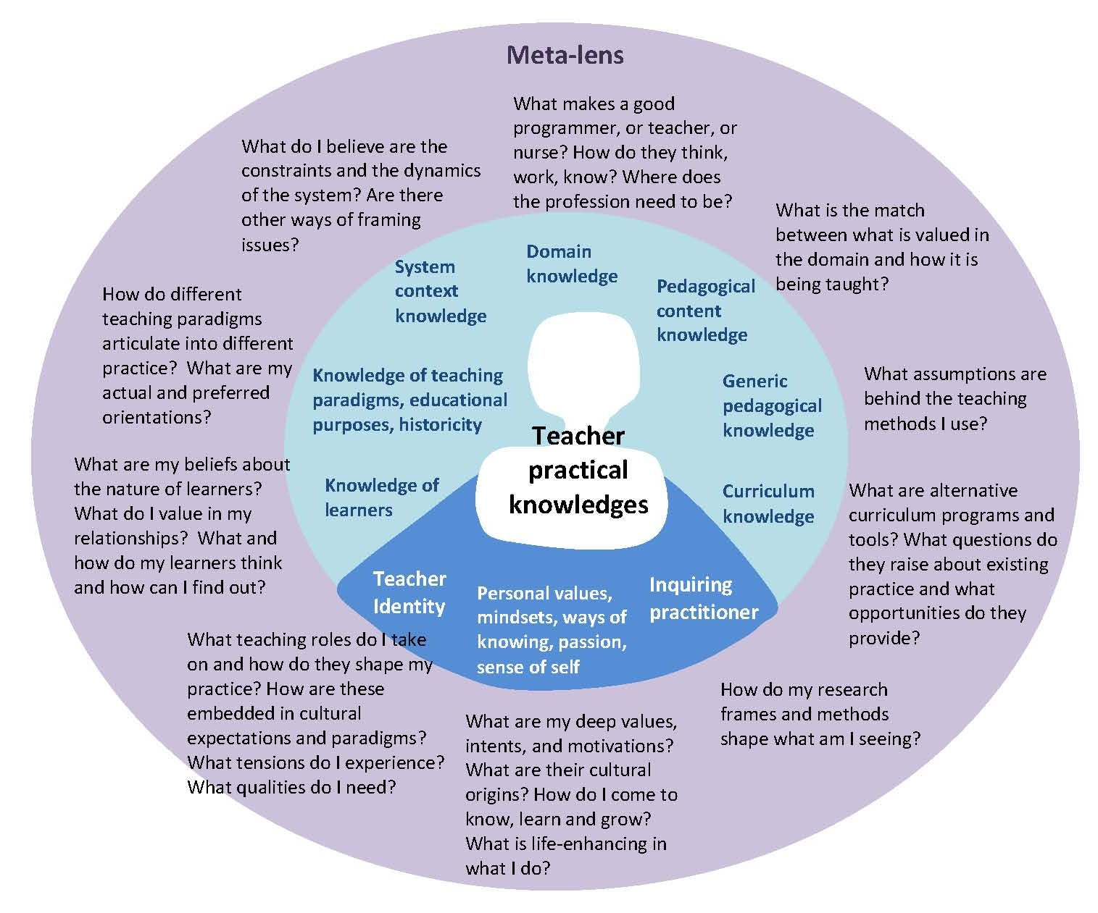
This ecology room was designed to make more visible the tacit “Teacher Knowledges” that we have.

Slide 34
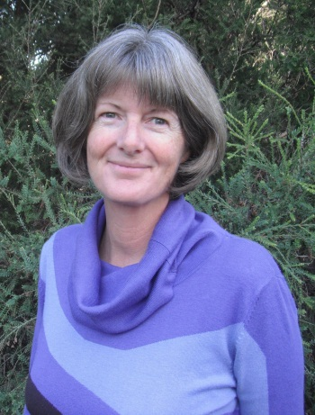
Acknowledgements The “ecology room” concept is the brainchild of Dr Sue Stack. Susan.Stack@utas.edu.au Many thanks to the participants of The ‘Who’ of Teaching workshop for allowing their work to be shared.

